Slide 1
Memory Management
Notes:
1
1
1
1
1

Slide 2
Unit 5: Memory Management (7 Hours)
Memory Management concepts:
Memory Management requirements,
Memory Partitioning: Fixed, Dynamic Partitioning,
Buddy Systems,
Fragmentation, Paging, Segmentation,
Address translation.
Virtual Memory:
Concepts,
Swapping,
VM with Paging, Page Table Structure,
Inverted Page Table, Translation Look aside Buffer, Page Size,
VM with Segmentation,
VM with combined paging and segmentation.
Swapping issues: Thrashing
2
Notes:
2
2
2
2
2
2
2

Slide 3
Memory Management
In a uniprogramming system, main memory is divided into two parts:
one part for the operating system (resident monitor, kernel) and
one part for the program currently being executed.
In a multiprogramming system, the “user” part of memory must be further subdivided to accommodate multiple processes.
The task of subdivision is carried out dynamically by OS is known as Memory Management.
Memory needs to be allocated to ensure a reasonable supply of ready processes to consume available processor time.
Memory Management, involves swapping blocks of data from secondary storage
Notes:
3
3
3
3
3

Slide 4
Execution of a Program
Operating system brings into main memory a few pieces of the program.
Resident set - portion of process that is in main memory.
An interrupt is generated when an address is needed that is not in main memory.
Operating system places the process in a blocking state.
Notes:
4
4
4
4
4

Slide 5
Memory Management Requirements
Relocation
Protection
Sharing
Logical organization
Physical organization
Notes:
5
5
5
5
5
The following slides expandon these topics.
5

Slide 6
Memory Management Terms
Term | Description
Frame | Fixed-length block of main memory.
Page | Fixed-length block of data in secondary memory (e.g. on disk).
Segment | Variable-length block of data that resides in secondary memory.
Notes:
6
6
6
6
6
6

Slide 7
Memory Management Requirements
1. Relocation:
Programmer does not know where the program will be placed in memory when it is executed.
While the program is executing, it may be swapped to disk and returned to main memory at a different location (relocated).
Memory references must be translated in the code to actual physical memory address.
Notes:
7
7
7
7
7

Slide 8
Memory Management Requirements
2. Protection
Each process should be protected against unwanted interference by other processes, whether accidental or intentional.
Processes should not be able to reference memory locations in another process without permission.
Impossible to check absolute addresses at compile time.
Must be checked at run time.
Memory protection requirement must be satisfied by the processor (hardware) rather than the operating system (software)
Operating system cannot anticipate all of the memory references a program will make
Notes:
8
8
8
8
8

Slide 9
Memory Management Requirements
3. Sharing
Allow several processes to access the same portion of memory
Ex. Number of processes executing same program
Better to allow each process access to the same copy of the program rather than have their own separate copy
Protection mechanism must have flexibility to allow several processes to access the same portion of memory
Processes that are cooperating on some task may need to share access to the same data structure.
Notes:
9
9
9
9
9

Slide 10
Memory Management Requirements
4. Logical Organization
Memory is organized linearly (usually)
- Main memory is usually organized as a linear, or 1-D address space, consisting of a sequence of bytes or words.
- Secondary memory, at its physical level, is similarly organized.
If memory can also be dealt with in form of modules, there are several advantages( Programs are written in modules)
Modules can be written and compiled independently
Different degrees of protection given to modules (read-only, execute-only)
Share modules among processes.
Ex: use of segmentation uses module concept
Notes:
10
10
10
10
10

Slide 11
Memory Management Requirements
5. Physical Organization
Memory is organized into Two –levels 1.main memory 2. secondary memory.
Main memory :fast , expensive, volatile
Secondary memory : Slow , less expensive, non-volatile
Flow of information b/n main & secondary memory is major concern
Can it be programmer’s responsibility?
Memory available for a program plus its data may be insufficient
Programmer does not know how much space will be available and where that space will be.
Notes:
11
11
11
11
11

Slide 12
Memory Management
Principal operation of MM is to bring process from secondary memory to main memory
This typically involves Virtual Memory which in turn involves segmentation and/or paging
Prior to Virtual Memory, other simpler techniques were used
Partitioning
Fixed
Variable / Dynamic
Concept of paging
Concept of segmentation
Notes:
12

Slide 13
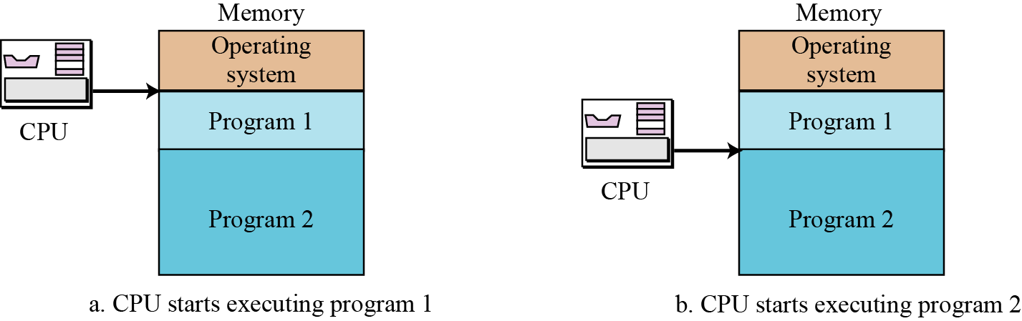
7.13
Notes:
13

Slide 14
Contiguous Memory Partitioning
Partition the available memory into regions with fixed boundaries.
1. Fixed Partitioning:
Equal-size Partitions
Unequal-size Partitions
2. Variable Partitioning
Notes:
14
14
14
14
14

Slide 15
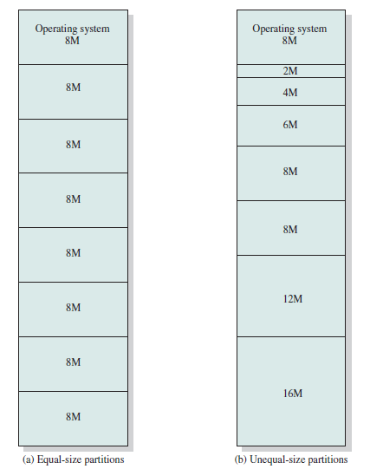

Slide 16
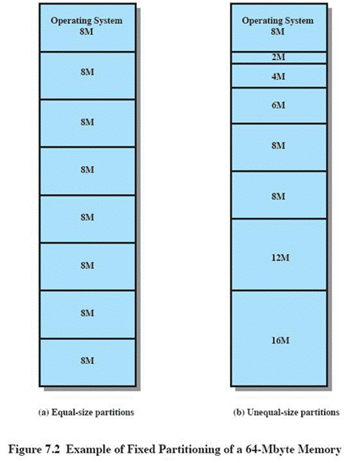
Fixed Partitioning
Equal-size partitions
Any process whose size is less than or equal to the partition size can be loaded into an available partition
If all partitions are full, the operating system can swap a process out of a partition
Notes:
16
16
16
16
16

Slide 17
Fixed Partitioning
Problems:
A program may be too big to fit in any partition.
Main memory use is inefficient.
Any program, no matter how small, occupies an entire partition.
In our example, there may be a program whose length is less than 2 Mbytes; yet it occupies an 8-Mbyte partition whenever it is swapped in.
This phenomenon, in which there is wasted space internal to a partition due to the fact that the block of data loaded is smaller than the partition, is referred to as internal fragmentation .
Notes:
17
17
17
17
17

Slide 18
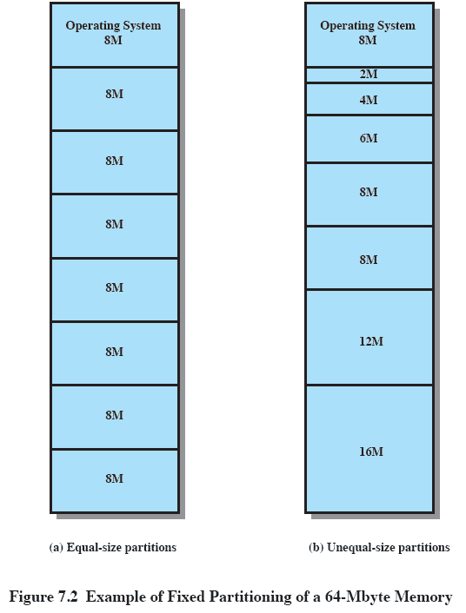
Solution: Unequal Size Partitions
Lessens both problems
but doesn’t solve completely
In Figure
Programs up to 16M can be accommodated without overlay
Smaller programs can be placed in smaller partitions, reducing internal fragmentation
Notes:
18
18
18
18
18

Slide 19
Placement Algorithm with Partitions
Equal-size partitions
Because all partitions are of equal size, it does not matter which partition is used.
If all partitions occupied with processes not ready to run, swap one out and load this guy in -Which one to swap out is a scheduling decision
Unequal-size partitions
Can assign each process to the smallest partition within which it will fit.
Queue for each partition.
Processes are assigned in such a way as to minimize wasted memory within a partition.
Two possible strategies
Notes:
19
19
19
19
19

Slide 20
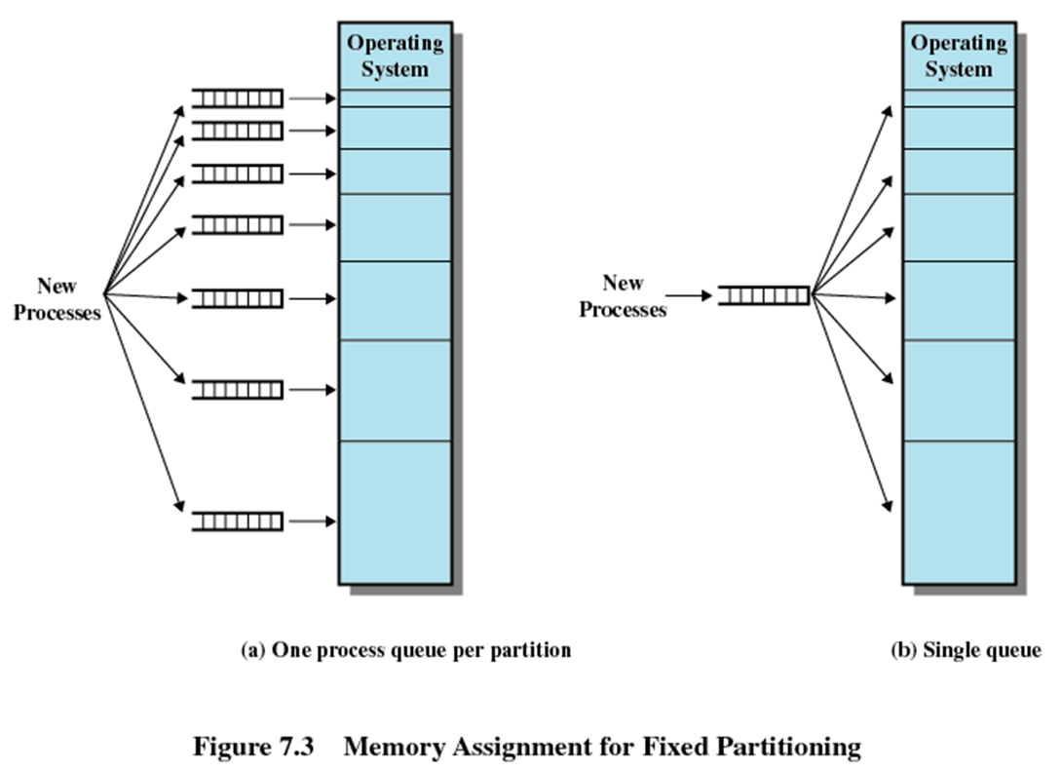
Strategy 1
Assign to smallest partition possible
May have to wait because somebody else is already there
Needs a scheduling queue for each partition to hold swapped out processes destined for that partition
If memory requirement is not clear, virtual memory are the only solutions
Advantage: minimum internal fragmentation
Disadvantage?
Small process cannot go to bigger partition even if available
Notes:
20
Small process cannot go to bigger partition even if available
20

Slide 21
Strategy 2
Single queue
Smallest available partition is selected when needed
If all are occupied, then swap out somebody
Smallest partition process that is enough to hold this guy
Priority
Process state
Notes:
21

Slide 22
Fixed Partitioning
Advantages
Simple, require minimal OS and processing overhead
Disadvantages
Number of partitions specified at system generation time limits the number of active processes system can support
Internal fragmentation cannot be completely eliminated
It is always possible to get small jobs which do not utilize partitions fully
Fixed partitioning is no where to be seen today
Example: IBM Mainframe's OS/MFT(Multiprogramming with fixed number of tasks)
Notes:
22

Slide 23
Dynamic Partitioning
Purpose: to overcome the difficulties of fixed partitioning
Partitions are of variable length and number.
Process is allocated exactly as much memory as required.
this method starts out well, but eventually it leads to a situation in which there are a lot of small holes in memory. As time goes on, memory becomes more and more fragmented, and memory utilization declines. This phenomenon is referred to as external fragmentation , indicating that the memory that is external to all partitions becomes increasingly fragmented.
Example:I BM Mainframe's OS/MVT OS/MFT(Multiprogramming with variable number of tasks)
Notes:
23
23
23
23
23

Slide 24
Dynamic Partitioning Example
External Fragmentation
Memory external to all processes is fragmented
Can resolve using compaction
OS (8M)
P1
(20M)
P2
(14M)
Empty (6M)
P2
(14M)
P4(8M)
Empty (56M)
Empty (6M)
P3
(18M)
Empty (4M)
Refer to Figure 7.4
Notes:
24
24
Animated slide
Imagine a system with 64M RAM
Initially, main memory is empty, except for the operating system
Three processes are loaded in – leaving a ‘hole’ too small for any further process
At some point, none of the processes in memory is ready. The operating system swaps out process 2,
Which leaves sufficient room to load a new process, process 4 – but that creates another hole
Later, a point is reached at which none of the processes in main memory is ready, but process 2, in the Ready-Suspend state, is available. Because there is insufficient room in memory for process 2, the operating system swaps process 1 out and swaps process 2 back in leaving yet another hole
Explain External Fragmentation and compaction – mention that compaction implies the capability of dynamic relocation
24

Slide 25
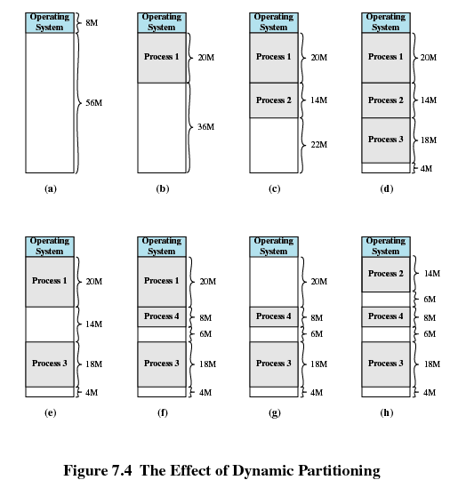
Dynamic Partitioning Example
Notes:
25
25
25
25
25

Slide 26
Dynamic Partitioning
- In Compaction, shuffle all occupied areas of memory to one end and leave all free memory space as a large block
- One technique for overcoming external fragmentation is compaction : From time to time, the OS shifts the processes so that they are contiguous and so that all of the free memory is together in one block.
Problem with compaction?
Extra overhead in terms of resource utilization & large response time
Expensive
Needs dynamic relocation of processes in memory

Slide 27
Contents
Memory Management requirements
Memory Partitioning: Fixed and Variable Partitioning,
Allocation Strategies (First Fit, Best Fit, and Worst Fit), Fragmentation, Swapping.
Virtual Memory: Concepts, Segmentation, Paging, Address Translation,
Page Replacement Policies (FIFO, LRU, Optimal, Other Strategies),
Thrashing.
OS Services layer in the Mobile OS: Multimedia and Graphics Services, Connectivity Services.
Notes:
27
27
27
27
27

Slide 28
Dynamic Partitioning Placement Algorithm
Purpose: To overcome on problem of compaction
Operating system must decide which free block to allocate to a process
When more than one choice available, OS must decide cleverly which hole to fill
Hole must be big enough to accommodate the to-be-loaded process
Placement algorithms:
First fit
Best fit
Next fit
Notes:
28
28
28
28
28

Slide 29
Dynamic Partitioning Placement Algorithm
First-fit algorithm
Scans memory from the beginning and chooses the first available block that is large enough
Simplest, Fastest
May have many process loaded in the front end of memory that must be searched over when trying to find a free block
Notes:
29
29
29
29
29

Slide 30
Dynamic Partitioning Placement Algorithm
Best-fit algorithm
scan all holes to see which is best
Chooses the block that is closest in size to the request
Worst performer overall
Since smallest block is found for process, the smallest amount of fragmentation is left
Memory compaction must be done more often
Notes:
30
30
30
30
30

Slide 31
Dynamic Partitioning Placement Algorithm
Next-fit
Scans memory from the location of the last placement
More often allocate a block of memory at the end of memory where the largest block is found
The largest block of memory is broken up into smaller blocks
Compaction is required to obtain a large block at the end of memory
Notes:
31
31
31
31
31

Slide 32
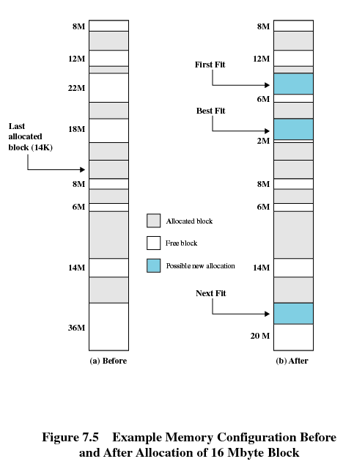
The last block that was used was a 22-Mbyte block from which a 14-Mbyte partition was created.
Notes:
32
32
32
32
32

Slide 33
Comparison
Depends on exact sequence of process swapping and size of processes
First fit
Simplest and usually the best and fastest
Splits regions towards beginning requiring more searches
Next fit produces slightly worse results than first fit
Tends to allocate more frequently towards the end of the memory, thus largest block of free memory which usually appears at the end is quickly fragmented requiring more frequent compaction
Best fit is usually the worst performer
Every allocation leaves behind smallest fragment of no good use
Requires compaction even more frequently
How about worst-fit strategy?
Worst-fit: Allocate the largest hole; must also search entire list
Produces the largest leftover hole
First-fit and best-fit better than worst-fit in terms of speed and storage utilization
Notes:
33

Slide 34
1. Given memory partitions of 100 KB, 500 KB, 200 KB, 300 KB, and 600 KB. How would each of the First fit, Best-Fit and Worst-Fit algorithms place processes of 212 KB, 417 KB, 112 KB, and 426 KB ? 2. Given memory partition of 100 KB, 500 KB, 200 KB and 600 KB (in order). Show with neat sketch how would each of the first-fit, best-fit and worst fit algorithms place processes of 412 KB, 317 KB, 112 KB and 326 KB (in order). Which algorithm is most efficient in memory allocation?

Slide 35
Buddy System
To overcome on the drawbacks of Fixed & Variable partitioning scheme.
Memory blocks are available of size 2^{K} words, where L<=K<=U
2^{L} Smallest size block that is allocated
2^{U} largest block that is allocated
Generally 2U is the size of entire memory available for allocation
Entire space available is treated as a single block of size 2^{U}
If a request of size s where 2^{U-1} < s <= 2^{U}
entire block is allocated
Otherwise block is split into two equal buddies of size 2^{U-1.}
Process continues until smallest block greater than or equal to s is generated
Notes:
In a fixed partitioning scheme limits the number of active processes and may use space inefficiently if there is a poor match between available partition sizes and process sizes.
A dynamic partitioning scheme is more complex to maintain and includes the overhead of compaction.
An interesting compromise is the buddy system.
35

Slide 36
Buddy System
The buddy system of partitioning relies on the fact that space
allocations can be conveniently handled in sizes of power of 2.
There are two ways in which the buddy system allocates space.
Suppose we have a hole which is the closest power of two. In that case, that hole is used for allocation.
In case we do not have that situation then we look for the next power of 2 hole size, split it in two equal halves and allocate one of these.
Because we always split the holes in two equal sizes, the two are “buddies”. Hence, the name buddy system.
The buddy system has the advantage that it minimizes the internal fragmentation.
In practice, some Linux flavors use it.

Slide 37
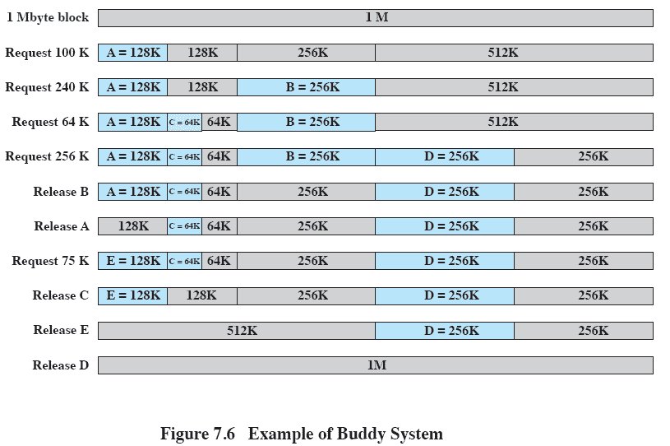
Example of Buddy System
Notes:
Figure 7.6 gives an example using a 1-Mbyte initial block.
The first request,A, is for 100 Kbytes, for which a 128K block is needed.
The initial block is divided into two 512K buddies.
The first of these is divided into two 256K buddies,
and the first of these is divided into two 128K buddies,
one of which is allocated to A.
The next request,B, requires a 256K block. Such a block is already available and is allocated.
The process continues with splitting and coalescing occurring as needed.
Note that when E is released,two 128K buddies are coalesced into a 256K block, which is immediately coalesced with its buddy
37

Slide 38
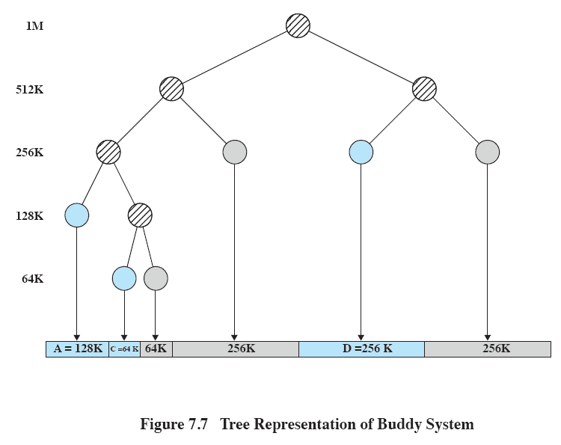
Tree Representation of Buddy System
Notes:
Figure 7.7 shows a binary tree representation of the buddy allocation immediately after the Release B request.
The leaf nodes represent the current partitioning the memory.
If two buddies are leaf nodes, then at least one must be allocated;
otherwise they would be coalesced into a larger block.
The buddy system is a reasonable compromise to overcome the disadvantages of both the fixed and variable partitioning schemes,
But in contemporary operating systems, virtual memory based on paging and segmentation is superior.
However, the buddy system has found application in parallel systems as an efficient means of allocation and release for parallel programs. A modified form of the buddy system is used for UNIX kernel memory allocation (described in Chapter 8).
38

Slide 39
Tree Representation of Buddy System
Figure 7.7 shows a binary tree representation of the buddy allocation immediately after the Release B request.
The leaf nodes represent the current partitioning the memory.
If two buddies are leaf nodes, then at least one must be allocated;
otherwise they would be coalesced into a larger block.
The buddy system is a reasonable compromise to overcome the disadvantages of both the fixed and variable partitioning schemes,
But in contemporary operating systems, virtual memory based on paging and segmentation is superior.
However, the buddy system has found application in parallel systems as an efficient means of allocation and release for parallel programs. A modified form of the buddy system is used for UNIX kernel memory allocation

Slide 40
Example on Buddy system
A minicomputer uses the buddy system for memory management. Initially it has one
block of 256K at address 0. After successive requests of 7K, 26K, 34K and 19K come in,
how many blocks are left and what are their sizes and addresses?

Slide 41
Example on Buddy system
Solution:
7K: We recursively break the address space into 2 halves until we have:
8K - 8K - 16K - 32K - 64K -128 K
The first segment is used to satisfy the 7K request.
26K: We use the 32K block to allocate the request.
8K - 8K - 16K - 32K - 64K -128 K
34K: We use the 64K block to satisfy the request:
8K - 8K - 16K - 32K - 64K -128 K
19K: Since 8K and 16K cannot satisfy the request on their own, we need to break the big
128K block recursively until we get the size we need. The blocks will look like:
8K - 8K - 16K - 32K - 64K - 32K - 32K - 64K

Slide 42
Example on Buddy system
A 1MB block of memory is allocated using the buddy system.Show the result of the following sequence:Request A 70,request B 35,request C 80, return A,request D 60,return B,return D,return C.
Show the binary tree representation following Return B

Slide 43
Contents
Memory Management requirements
Memory Partitioning: Fixed and Variable Partitioning,
Allocation Strategies (First Fit, Best Fit, and Worst Fit), Fragmentation, Swapping.
Paging, Segmentation, Address Translation,
Page Replacement Policies (FIFO, LRU, Optimal, Other Strategies),
Thrashing.
Notes:
43
43
43
43
43

Slide 44
Addresses
Logical
Reference to a memory location independent of the current assignment of data/instruction to memory. Generated by CPU
Relative
Type of logical address wherein address is specified as a location relative to some known point, say a value in a register
Physical or Absolute
The absolute address or actual location in main memory.
Typically, all of the memory references in a loaded process are relative to the base address
Hardware mechanism is used to translate logical/relative to physical at the time of execution of instruction that contains the reference
Notes:
44
44
44
44
44

Slide 45
Paging
Fixed & variable size partitions are insufficient as involves internal / external fragmentation.
What were the two problems with equal sized fixed partitions?
Program too large for a partition
Program too small for a partition
Partition memory into small equal fixed-size chunks and divide each process into the same size chunks.
The chunks of a process are called pages and chunks of memory are called frames.
Operating system maintains a page table for each process
Contains the frame location for each page in the process
Memory address consist of a page number and offset within the page
Page number is used as an index to page table.
Notes:
45
45
45
45
45

Slide 46
Paging
Each process has its own page table.
Each page table entry contains the frame number of the corresponding page in main memory
A bit is needed to indicate whether the page is in main memory or not.
No external fragmentation
all frames (physical memory) can be used by processes
Possibility of Internal fragmentation
The physical memory used by a process is no longer contiguous
The logical memory of a process is still contiguous
The logical and physical addresses are separated
the process does not see the translation or the difference to having physical memory
Notes:
46
46
46
46
46

Slide 47
Advantages of Breaking up a Process
More processes may be maintained in main memory
Only load in some of the pieces of each process
With so many processes in main memory, it is very likely a process will be in the Ready state at any particular time
A process may be larger than all of main memory
Notes:
47
47
47
47
47

Slide 48
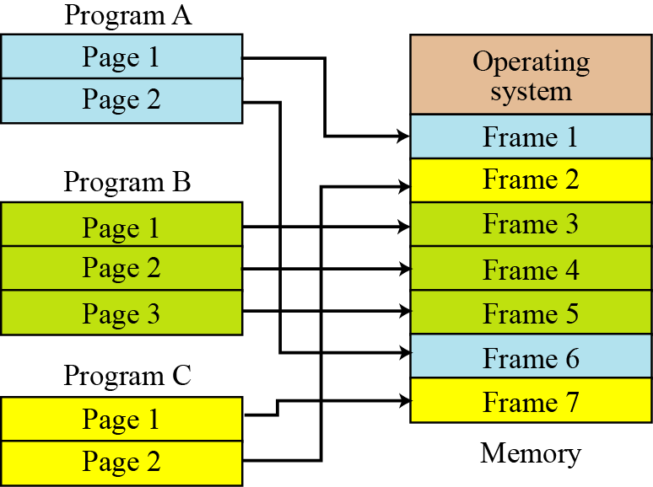
7.48
Notes:
48

Slide 49
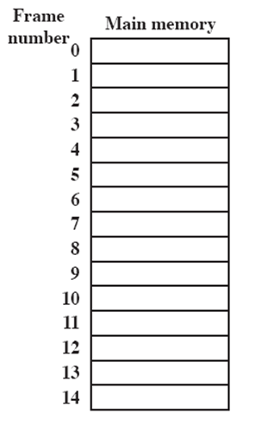
Processes and Frames
A.0
A.1
A.2
A.3
B.0
D.0
B.1
D.1
B.2
D.2
C.0
C.1
C.2
C.3
D.3
D.4
Notes:
49
49
49
49
Animated slide
System with a number of frames allocated
Process A, stored on disk, consists of four pages. When it comes time to load this process, the operating system finds four free frames and loads the four pages of process A into the four frames.
Process B, consisting of three pages, and process C, consisting of four pages, are subsequently loaded.
Then process B is suspended and is swapped out of main memory.
Later, all of the processes in main memory are blocked, and the operating system needs to bring in a new process, process D, which consists of five pages. The Operating System loads the pages into the available frames and updates the page table
49

Slide 50
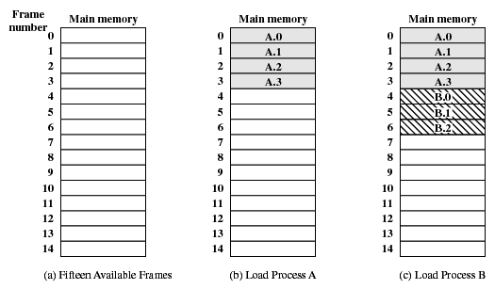
Assignment of Process Pages to Free Frames
Notes:
50
50
50
50
50

Slide 51
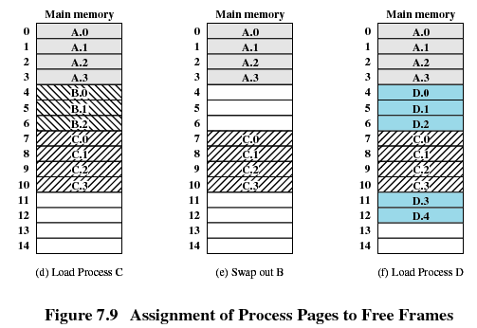
Assignment of Process Pages to Free Frames
Notes:
51
51
51
51
51

Slide 52
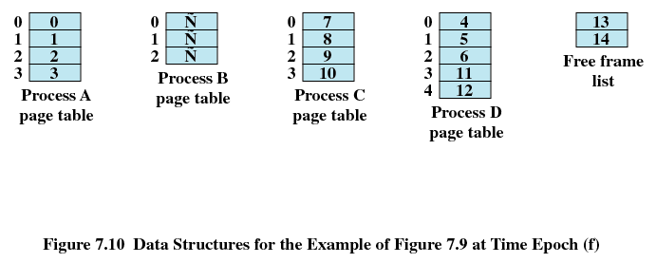
Page Tables for Example
Notes:
52
52
52
52
52

Slide 53

Paging
The page size is defined by the hardware.
The page size is typically a power of 2.The size can be 512 bytes to 16 MB.
The selection of power of 2 as a page size makes translation of logical address into a page number and page offset easy.
Address generated by CPU is divided into:
Page number (p) – used as an index into a page table which contains base address of each page in physical memory
Page offset (d) – combined with base address to define the physical memory address that is sent to the memory unit.
For given logical address space 2^{m} and page size 2^{n}
Notes:
53
53
53
53
53

Slide 54
Paging- Summary
The with simple paging, main memory is divided into many small equal-size frames.
Each process is divided into frame-size pages.
Smaller processes require fewer pages; larger processes require more.
When a process is brought in, all of its pages are loaded into available frames, and a page table is set up.
This approach solves many of the problems inherent in partitioning
Notes:
54
54
54
54
54

Slide 55
Segmentation
User program and associated data now divided not into pages, but segments which could be of unequal size
All segments of all programs do not have to be of the same length, May be unequal, dynamic size
There is a maximum segment length, Simplifies handling of growing data structures
Logical Address consist of two parts - a segment number and an offset
Similar to dynamic partitioning
A program however can now occupy more than one partitions
Partitions need not be contiguous
Notes:
55
55
55
55
55

Slide 56
Segmentation
Paging is invisible to the programmer, segmentation is usually visible and is provided as a convenience for organizing programs and data
Compiler or programmer assigns programs and data to different segments
One program may be further broken down into multiple segments for purposes of modular programming
Allows programs to be altered and recompiled independently
Simplifies handling of growing data structures
Logical address to physical address translation is now little complicated but similar
Segment table
Length of segment and starting physical address
Notes:
56

Slide 57
Segment Organization
Starting address corresponding segment in main memory
Each entry contains the length of the segment
A bit is needed to determine if segment is already in main memory
Another bit is needed to determine if the segment has been modified since it was loaded in main memory
Notes:
57
57
57
57
57

Slide 58
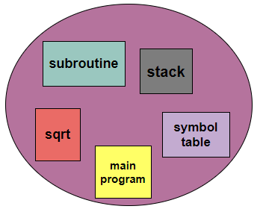
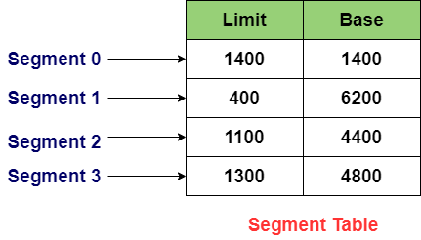
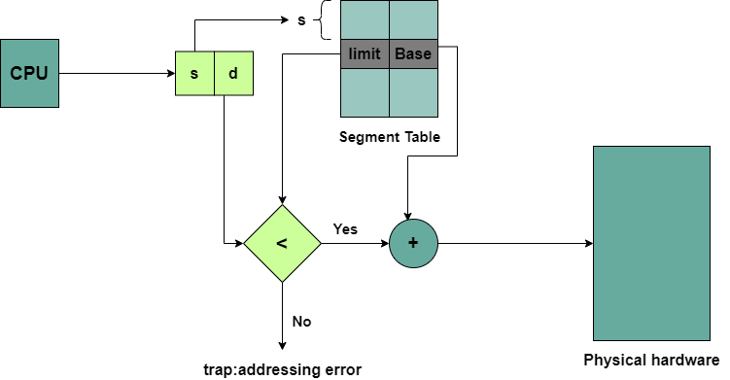

Slide 59
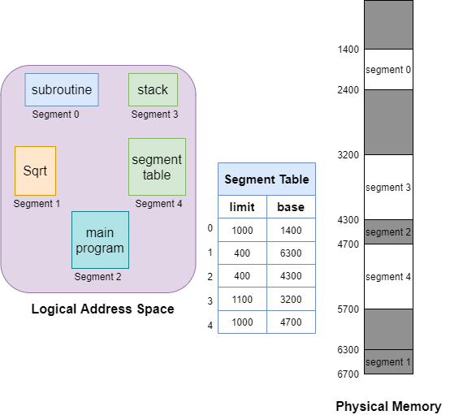

Slide 60
Address translation
Extract segment number from logical address (left most n bits)
Find base address of this segment from segment table
Compare offset (rightmost m bits) with segment length
If ok, desired physical address = base address + offset
Notes:
60

Slide 61
Segment no | Start | Length | End (start+length)
S2 | 222 | 198 | 420
S0 | 660 | 248 | 908
S3 | 996 | 604 | 1600
S1 | 1752 | 422 | 2174
(0,198): 660+198=858
(2,156)=222+156=377
(1,530)=invalid,as offset > length
(3,444)=996+444=1440
(0,222)=Invalid as offset > length

Slide 62
Example
8-bit virtual address, 10-bit physical address, and each page is 64 bytes.
How many virtual pages?
How many physical pages?
How many entries in page table?
Given page table = [2, 5, 1, 8], what’s the physical address for virtual address 241?
4 pages
16 frames
4 PTE
561

Slide 63
Virtual Memory : Paging & Segmentation
Notes:
63
63
63

Slide 64
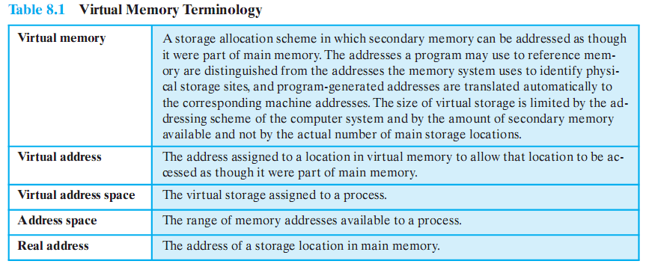
Addresses
Notes:
64
64
64
64
64

Slide 65
Key points in Memory Management
1) Memory references are logical addresses dynamically translated into physical addresses at run time
A process may be swapped in and out of main memory occupying different regions at different times during execution
2) A process may be broken up into pieces that do not need to located contiguously in main memory
Portion of a process that is in memory at any given time is called resident set of the process
Notes:
65
65
65
65
65

Slide 66
Breakthrough in Memory Management
If both of those two characteristics are present,
then it is not necessary that all of the pages or all of the segments of a process be in main memory during execution.
If the next instruction, and the next data location are in memory then execution can proceed
at least for a time
Notes:
66
66
66
66
66

Slide 67
Background
Virtual memory – separation of user logical memory from physical memory.
Only part of the program needs to be in memory for execution
Logical address space can therefore be much larger than physical address space
Allows address spaces to be shared by several processes
Allows for more efficient process creation
Virtual memory can be implemented via:
Demand paging
Demand segmentation
Notes:
67
67
67
67

Slide 68
Virtual Memory
Demand paging and demand segmentation mean that, when a program is being executed, part of the program is in memory and part is on disk.
This means that, for example, a memory size of 10 MB can execute 10 programs, each of size 3 MB, for a total of 30 MB.
At any moment, 10 MB of the 10 programs are in memory and 20 MB are on disk. There is therefore an actual memory size of 10 MB, but a virtual memory size of 30 MB. Figure 7.11 shows the concept. Virtual memory, which implies demand paging, demand segmentation or both, is used in almost all operating systems today.
7.68
Notes:
68

Slide 69
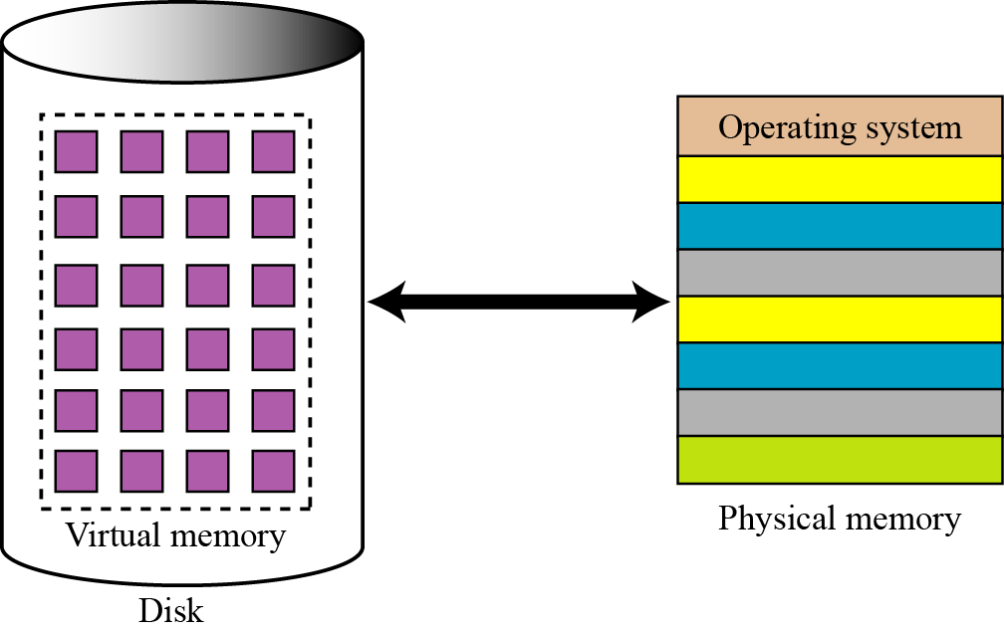
Virtual Memory
7.69
Notes:
69

Slide 70
Virtual Memory
If a ‘piece’ is not in memory and is required, processor generates interrupt indicating memory access fault
OS takes charge, puts process in blocked state
OS issues disk I/O to bring in the desired piece
Schedules another process in the mean time
Once brought in, I/O interrupt is raised, OS takes control again and puts the process in Ready queue
VM 🡪 Virtual Memory, Virtual Machine
Notes:
70

Slide 71
Advantages of having only a portion
More processes in memory at a given time with increase in CPU utilization, throughput but no increase in response time & turnaround time
Processes can now be larger than main memory without any tension on part of the programmer (overlaying)
Why to waste memory with portions of program/data which are being used only rarely
Time is saved as unused pieces are not being swapped in/out
Less I/O needed to load or swap user programs into memory, so each user program would run faster.
Notes:
71

Slide 72
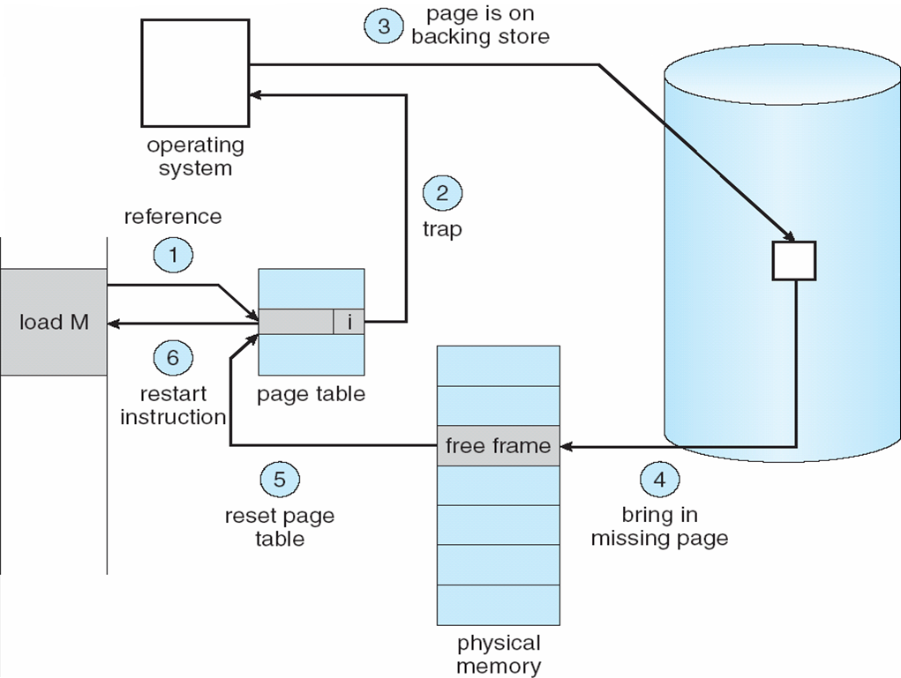
Steps in handling a page fault
Notes:
72

Slide 73
Issues
To bring in a piece, some other piece needs to be thrown out
Piece is thrown out just before it is used
Go get that piece again almost immediately
Leads to thrashing
System spends to much time swapping the pieces rather than executing instructions
Problem is worsened if OS mistakes it to be an indicator to increase the level of multi programming
Solution: OS tries to guess which pieces are least likely to be used in the near future
Notes:
73

Slide 74
Virtual Memory Requirements
Hardware must support paging and/or segmentation
OS must support swapping of pages and/or segments
Notes:
74

Slide 75
Virtual Memory + Paging
Earlier paging: when all pages of a process are loaded into memory, its page table is created and loaded
Page Table Entry (PTE) now needs to have
An extra bit to indicate whether page is in memory or not (P)
Another bit to indicate whether it is modified since it was last loaded (M)
When somebody else comes to replace me, I will not need to be written back to disk
Some control bits
For example protection or sharing at page level
Notes:
75

Slide 76
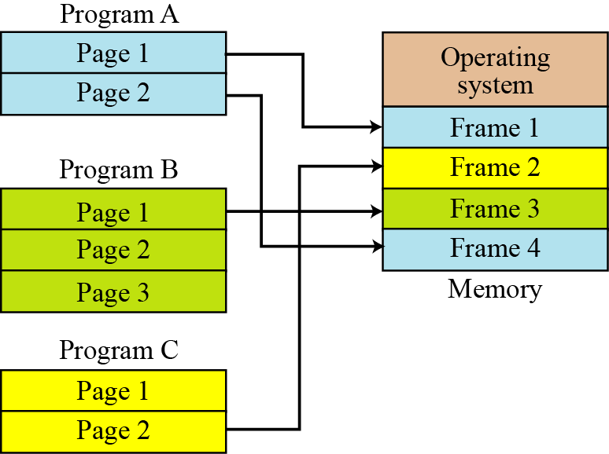
Virtual Memory + Paging /Demand Paging
7.76
Notes:
76

Slide 77
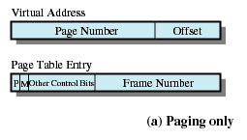
Page Table Entry
Present bit
Modify bit
Notes:
77
77
77
77
77

Slide 78
Page protection
Implemented by associating protection bits with each virtual page in page table
Protection bits
present bit: map to a valid physical page?
read/write/execute bits: can read/write/execute?
user bit: can access in user mode?
x86: PTE_P, PTE_W, PTE_U
Checked by MMU on each memory access
Notes:
78
78
78
78

Slide 79
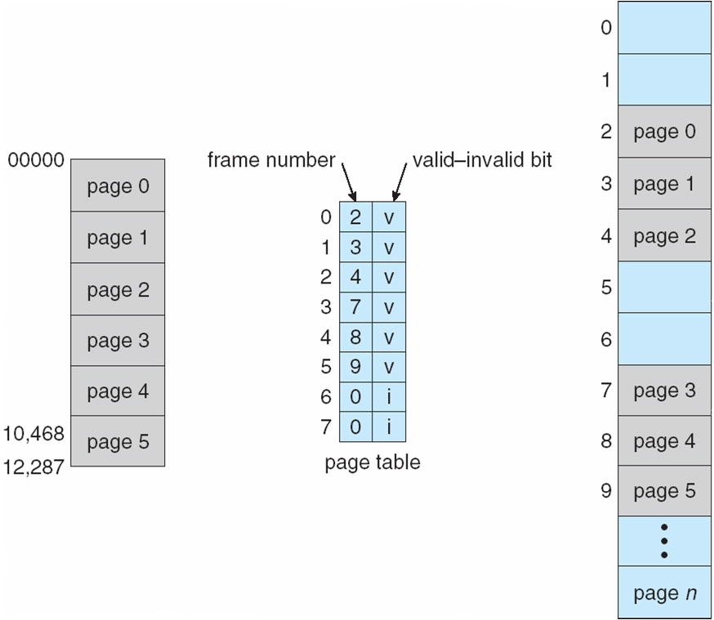
Example:Valid (v) or Invalid (i) Bit In A Page Table
Process
Main Memory
Notes:
79
79
79
79
79
79
79

Slide 80
Demand paging
Page is needed 🡪 reference to it
invalid reference 🡪 abort
not-in-memory 🡪 bring to memory
Lazy swapper – never swaps a page into memory unless page will be needed
Swapper that deals with pages is a pager
Notes:
80

Slide 81
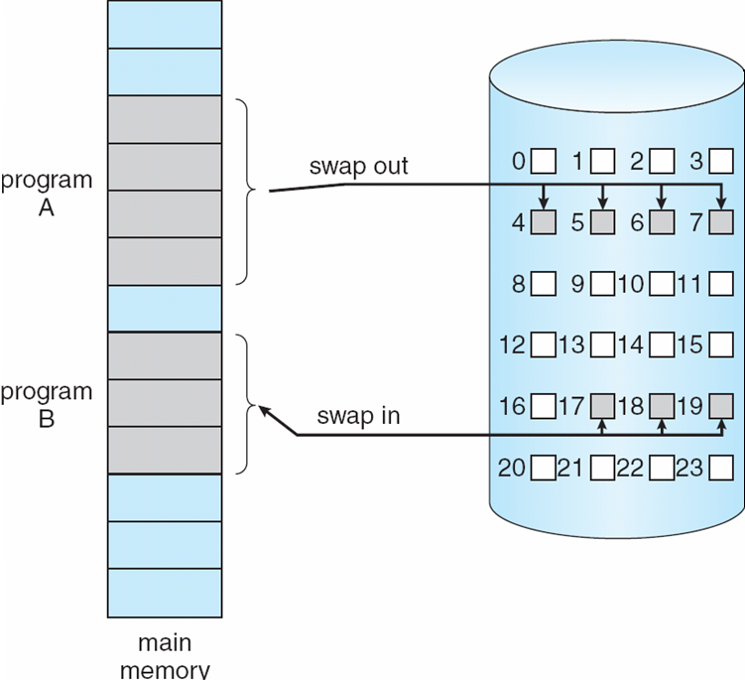
Transfer of a Paged Memory to Contiguous Disk Space
Notes:
81
81
81
81

Slide 82
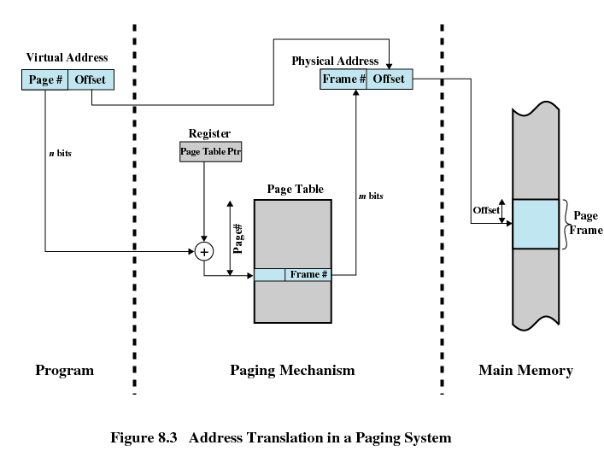
Address Translation in Paging
Page number field > frame number field n>m
Notes:
82
82
82
82
82

Slide 83
Page Tables
Generally one page table per process
Let us say a process requires 2GB virtual memory
How many 512 bytes pages will it contain?
As the size of page table increases, amount of memory required by it could be unacceptably high
Page tables are also stored in virtual memory
Page tables are subject to paging as other pages
When a process is running, part of its page table must be in main memory.
Page-table base register (PTBR) points to the page table
Page-table length register (PRLR) indicates size of the page table
In this scheme every data/instruction access requires two memory accesses. One for the page table and one for the data/instruction.
2^31 pages /process
2^31/2^9=2^22 pages /process
Notes:
83
83
83
83
83

Slide 84
Translation Lookaside Buffer
Each virtual memory reference can cause two physical memory accesses
One to fetch appropriate page table
One to fetch appropriate data
Effect of doubling the memory access time!
To overcome this problem a high-speed cache is set up for page table entries
Called a Translation Lookaside Buffer (TLB)
Contains page table entries that have been most recently used
Notes:
84
84
84
84
84

Slide 85
TLB Operation
Given a virtual address, processor examines the TLB
If page table entry is present (TLB hit), the frame number is retrieved and the real address is formed
If page table entry is not found in the TLB (TLB miss), the page number is used to index the process page table
First checks if page is already in main memory
If yes, go ahead, update TLB to include this new entry
If no, a page fault is issued to get the page (OS takes over), page table is updated, instruction is re-executed
It have entries between 64 to 1024
Notes:
85
85
85
85
85

Slide 86
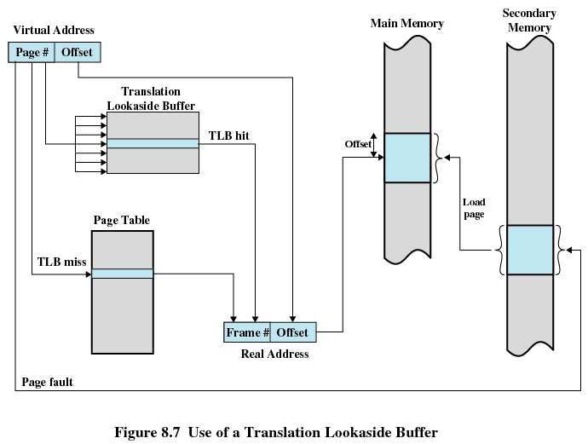
Translation Lookaside Buffer
Notes:
86
86
86
86
86

Slide 87
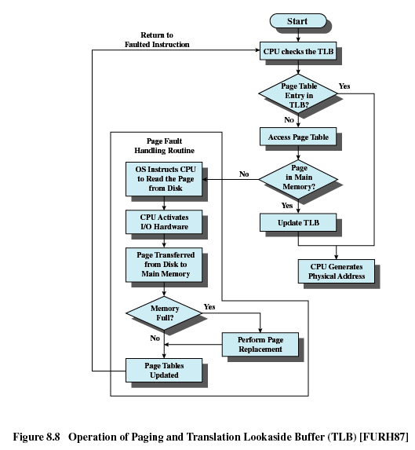
TLB Operation
Notes:
87
87
87
87
87

Slide 88
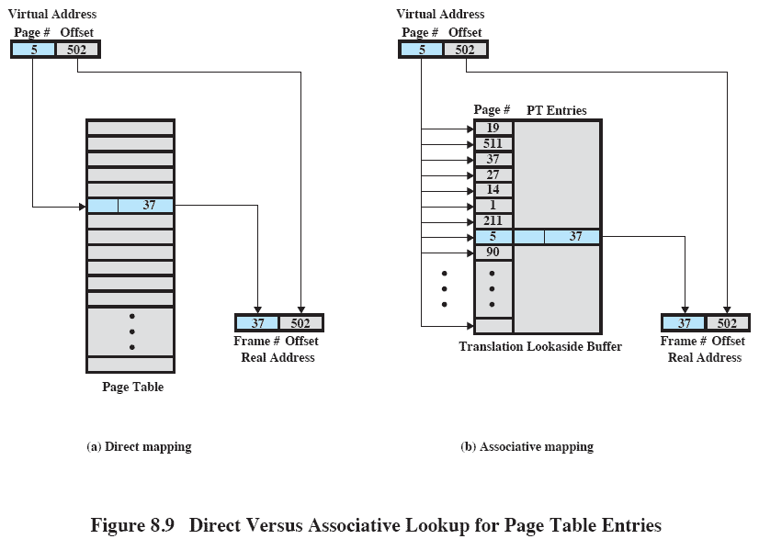
Translation Lookaside Buffer
Notes:
88

Slide 89
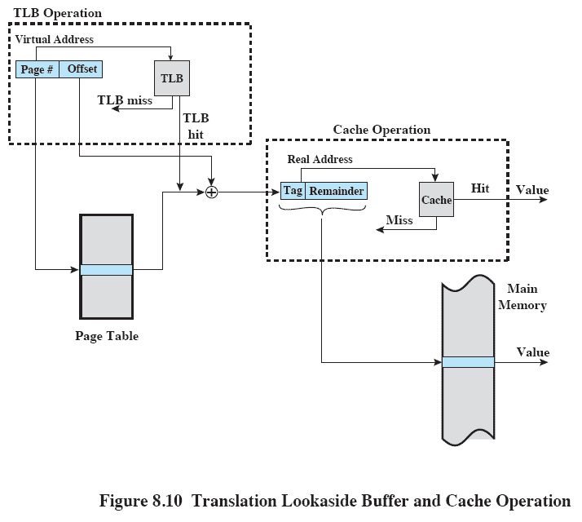
Translation Lookaside Buffer
Notes:
89

Slide 90
Page table size issues
Given:
A 32 bit address space (4 GB)
4 KB pages
A page table entry of 4 bytes
Implication: page table is 4 MB per process!
Observation: address space are often sparse
Few programs use all of 2^32 bytes
Change page table structures to save memory
Trade translation time for page table space
Solution: Hierarchical page table

Slide 91
Two Level Hierarchical Page Table
Some processor makes use of two-level scheme to organize large page tables
There is a page directory
Each entry points to a page table
If length of page directory is X & maximum length of a page table is Y,
A process can consist of up to X*Y pages.
Maximum length of a page table is restricted to be equal to one page

Slide 92
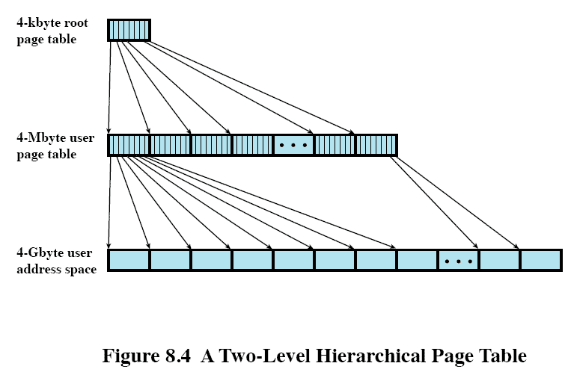
Two Level Hierarchical Page Table
4kbyte=2^12=page size
PTE=2^2
2^32
Pages=2^20

Slide 93
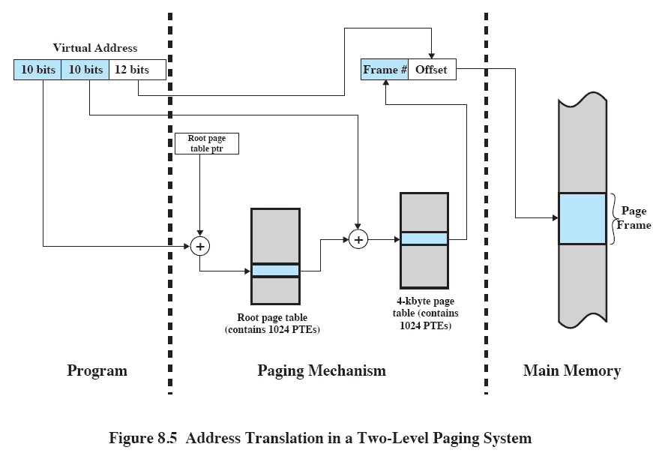
Address Translation in Two-Level Paging System

Slide 94
Inverted Page Table
Used on PowerPC, UltraSPARC, and IA-64 architecture
Page number portion of a virtual address is mapped into a hash value
Hash value points to inverted page table
Fixed proportion of real memory is required for the tables regardless of the number of processes
Notes:
94

Slide 95
Inverted Page Table
Page number
Process identifier
Control bits
Chain pointer
Notes:
95

Slide 96
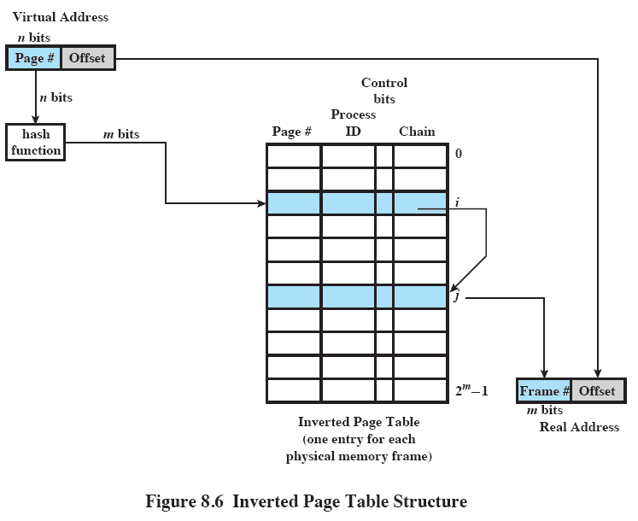
Inverted Page Table
Notes:
96

Slide 97
Page Size
Effect on internal fragmentation?
Smaller 🡺 less internal fragmentation
optimal memory utilization-We want less internal fragmentation
Keep page size small
But small page size 🡺 more number of pages per process 🡺 larger page tables 🡺 using virtual memory for page table 🡺 potential double page fault!
Further, larger page size 🡺 more efficient block transfer of data
Due to physical characteristics of rotational devices
Vishal Kaushal
Notes:
97

Slide 98
Page Size
Secondary memory is designed to efficiently transfer large blocks of data so a large page size is better
Small page size, large number of pages will be found in main memory
As time goes on during execution, the pages in memory will all contain portions of the process near recent references => Page faults low.
Increased page size causes pages to contain locations further from any recent reference => Page faults rise.
Notes:
98
98
98
98
98

Slide 99
Effect of page size on number of page faults
With very small page size
More pages in memory, thus lesser page faults
Greater effect of principle of locality
One page refers to nearby locations
As page size increases
Lesser pages in memory, thus more page faults
Effect of locality reduced
Each page will contain locations further and further away from recent references
Page fault rate is also determined by the number of frames allocated to a process.
3. Size of physical memory & program size:
Vishal Kaushal
Notes:
99

Slide 100
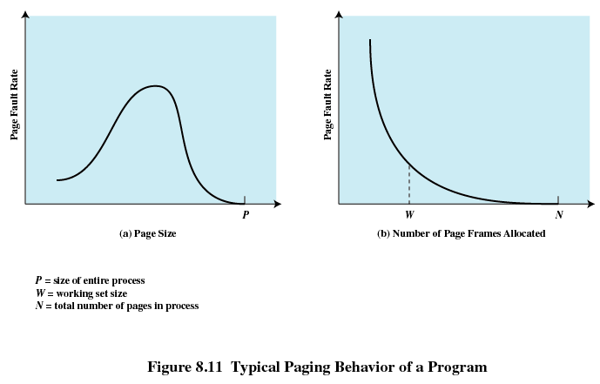
Page Size
Notes:
100
100
100
100
100

Slide 101
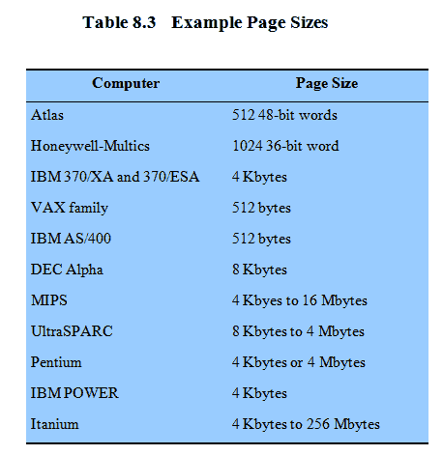
Example Page Size
Notes:
101
101
101
101
101

Slide 102
Ordinary Paging vs VM Paging
Paging | Virtual memory paging
Main memory partitioned small into fixed -size chunks called frames | Main memory partitioned into small fixed -size chunks called frames
Program broken into pages by the compiler or memory management system | Program broken into pages by the compiler or memory management system
Internal fragmentation within frames | Internal fragmentation within frames
No external fragmentation | No external fragmentation
OS must maintain page table for each process showing which frame each page occupies | OS must maintain page table for each process showing which frame each page occupies
OS must maintain a free frame list | OS must maintain a free frame list
Processor uses page number, offset to calculate absolute address | Processor uses page number, offset to calculate absolute address
All the pages of a process must be in main memory for process to run, unless overlays are used | Not All the pages of a process must be in main memory for process. Page may be read in as needed
 | Reading a page into main memory may require writing a page out to disk
Notes:
102
Demand paging
102

Slide 103
Segmentation
Memory consist of multiple address space/segments
Segments may be of unequal/dynamic in size
Memory reference consist of segment number, offset to form address.
Have advantages to programmer over non segmented memory
Easier to relocate segment than entire program
Simplifies handling of growing data structures
Allows programs to be altered and recompiled independently
Sharing among processes
Provides protection
Avoids allocating unused memory (no internal fragmentation)
Efficient translation -> Segment table small ( fit in MMU )
Disadvantages
Segments have variable lengths -> how to fit?
Segments can be large -> external fragmentation
Notes:
103
103

Slide 104
VM + Segmentation
Earlier segmentation: each process has its own segment table
When all of its segments are loaded into main memory, segment table is created and loaded
With VM, STEs become more complex
P bit (present/absent)
M bit (modify)
Other control bits
For example to support sharing or protection at segment level
Notes:
104

Slide 105
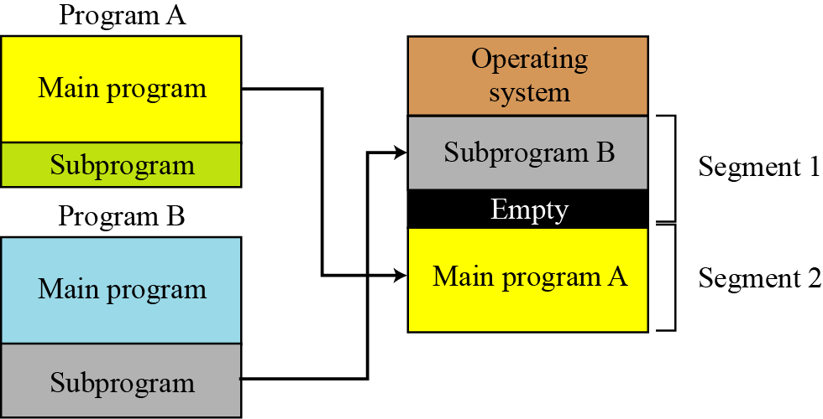
VM + Segmentation
7.105
Notes:
105

Slide 106
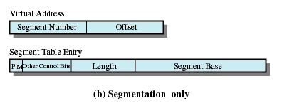
Segment Table Entries
Present bit
Modify bit
Notes:
106
106
106
106
106

Slide 107
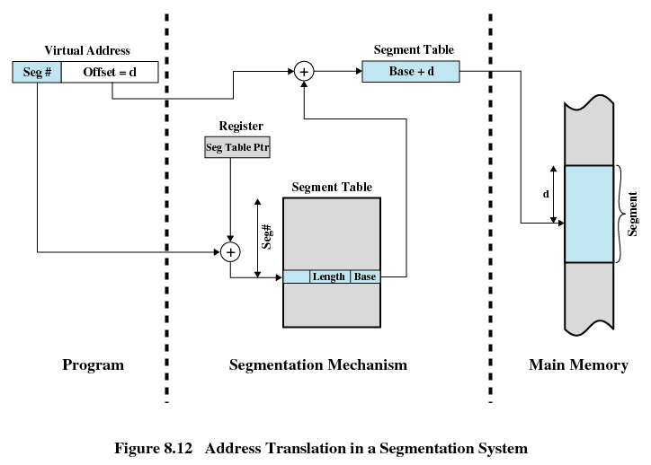
Address Translation in Segmentation
Notes:
107
107
107
107
107

Slide 108
Ordinary Segmentation vs VM Segmentation
Simple Segmentation | Virtual memory segmentation
Main memory not partitioned | Main memory not partitioned
Program segments specified by the programmer to the compiler | Program segments specified by the programmer to the compiler
No Internal fragmentation | No Internal fragmentation
External fragmentation | External fragmentation
OS must maintain segment table for each process showing the load address and length of each segment | OS must maintain segment table for each process showing the load address and length of each segment
OS must maintain a list of holes | OS must maintain a list of holes
Processor uses segment number, offset to calculate absolute address | Processor uses segment number, offset to calculate absolute address
All the segments of a process must be in main memory for process to run, unless overlays are used | Not all the segments of a process must be in main memory for process to run. Segment s may be read in as needed
 | Reading a segment into main memory may require writing one/more segments out to disk
Notes:
108
108

Slide 109
Contents
Memory Management requirements
Memory Partitioning: Fixed and Variable Partitioning,
Allocation Strategies (First Fit, Best Fit, and Worst Fit), Fragmentation, Swapping.
Virtual Memory: Concepts, Segmentation, Paging, Address Translation,
Page Replacement Policies (FIFO, LRU, Optimal, Other Strategies),
Thrashing.
OS Services layer in the Mobile OS: Multimedia and Graphics Services, Connectivity Services.
Notes:
109
109

Slide 110
What happens when there is no free frame?
Notes:
110

Slide 111
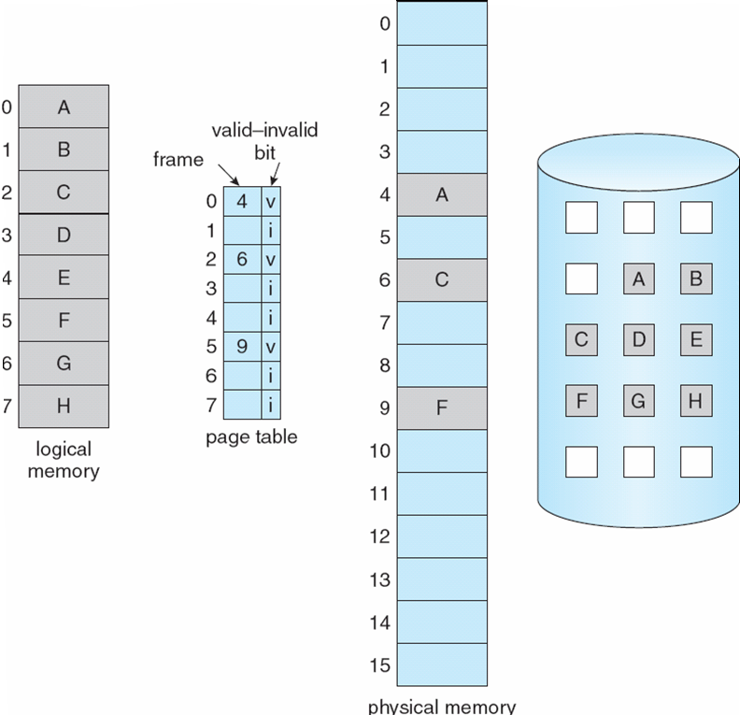
Page Table When Some Pages Are Not in Main Memory
Notes:
111
111
111
111

Slide 112
Page Fault
If there is a reference to a page, first reference to that page will trap to operating system:
page fault
Operating system looks at another table to decide:
Invalid reference ⇒ abort
Just not in memory
Get empty frame
Swap page into frame
Reset tables
Set validation bit = v
Restart the instruction that caused the page fault
Notes:
112
112
112
112

Slide 113
Steps in handling a page fault
Notes:
113

Slide 114
What happens if there is no free frame?
Page replacement – find some page in memory, but not really in use, swap it out
Different algorithms, different performance
Want an algorithm which will result in minimum number of page faults
Same page may be brought into memory several times
Notes:
114
114
114
114

Slide 115
Page Replacement
Prevent over-allocation of memory by modifying page-fault service routine to include page replacement
Use modify (dirty) bit to reduce overhead of page transfers – only modified pages are written to disk
Page replacement completes separation between logical memory and physical memory – large virtual memory can be provided on a smaller physical memory
Notes:
115
115
115
115

Slide 116
Basic Page Replacement
Find the location of the desired page on disk
Find a free frame: - If there is a free frame, use it - If there is no free frame, use a page replacement algorithm to select a victim frame
Bring the desired page into the (newly) free frame; update the page and frame tables
Restart the process
Notes:
116
116
116
116

Slide 117
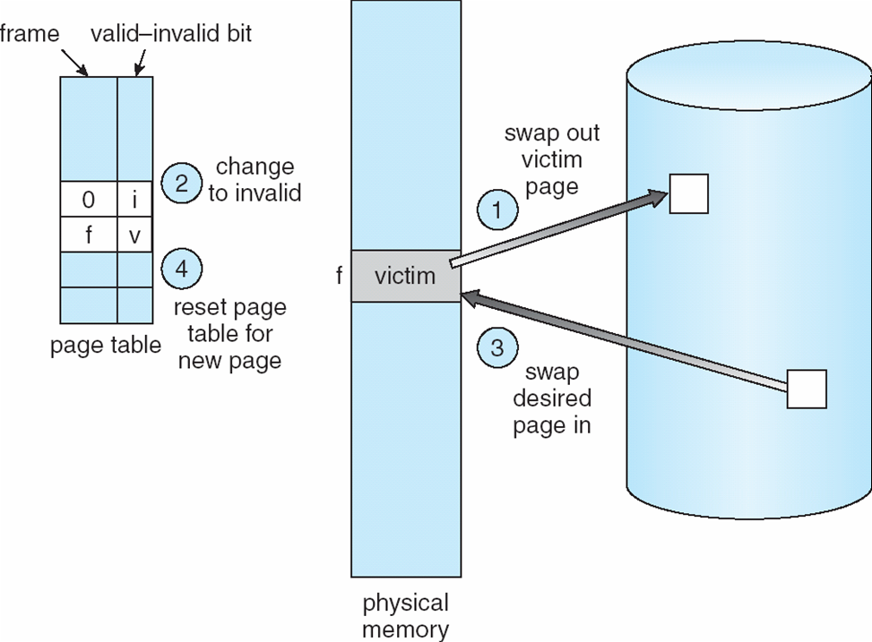
Page Replacement
Notes:
117
117
117
117

Slide 118
Page-Replacement Algorithms
Want lowest page-fault rate.
Evaluate algorithm by running it on a particular string of memory references (reference string) and computing the number of page faults on that string.
In all our examples, the reference string is
A B C A B D A D B C B
Notes:
118

Slide 119
Basic Replacement Algorithms
First-in, first-out (FIFO)
Treats page frames allocated to a process as a circular buffer
Pages are removed in round-robin style
Simplest replacement policy to implement
Page that has been in memory the longest is replaced
These pages may be needed again very soon
How would you implement FIFO strategy?
Keep a queue and do round robin
Notes:
119
119

Slide 120
Example: FIFO
Suppose we have 3 page frames, 4 virtual pages, and following reference stream:
A B C A B D A D B C B
Consider FIFO Page replacement:
FIFO: 7 faults.
When referencing D, replacing A is bad choice, since need A again right away
Ref:
Page:
A
B
C
A
B
D
A
D
B
C
B
1
A
D
C
2
B
A
3
C
B
Notes:
120

Slide 121
Basic Replacement Algorithms
Optimal policy
Selects for replacement that page for which the time to the next reference is the longest
Impossible to have perfect knowledge of future events
Notes:
121
121

Slide 122
Example: Optimal(MIN)
Suppose we have the same reference stream:
A B C A B D A D B C B
Consider Optimal Page replacement:
MIN: 5 faults
Where will D be brought in? Look for page not referenced farthest in future.
Ref:
Page:
A
B
C
A
B
D
A
D
B
C
B
1
A
C
2
B
3
C
D
Notes:
122

Slide 123
Basic Replacement Algorithms
Least Recently Used (LRU)
Replaces the page that has not been referenced for the longest time
By the principle of locality, this should be the page least likely to be referenced in the near future
Each page could be tagged with the time of last reference. This would require a great deal of overhead.
Notes:
123
123

Slide 124
Example: LRU
Suppose we have the same reference stream:
A B C A B D A D B C B
Consider LRU Page replacement:
LRU: 5 faults
What will LRU do?
Same decisions as MIN here, but won’t always be true!
Ref:
Page:
A
B
C
A
B
D
A
D
B
C
B
1
A
C
2
B
3
C
D
Notes:
124

Slide 125
LRU Algorithm (Cont.)
How would you implement LRU strategy?
Stack implementation – keep a stack of page numbers in a double link form:
Any time Page is referenced move it to the top
Replace page from the bottom of the stack
No search for replacement
Notes:
125
125
125
125

Slide 126
Comparison of Algorithms
 | FIFO | OPT/MIN | LRU
Data structure for implementation | Queue | NA | DLL using counter or stack method
Traversal of reference string | Forward | Forward | Backward
Implementation | Easy to understand n imple. | Diff. to impl. | Approximation of OPT ,impl is possible
Performance | Not good | Mainly used for comparison study | Good
Time to be considered | Uses the time when page was brought into memory | Uses the time when a page is to be used | Approximation of OPT , Uses the time when a page is used
Notes:
126

Slide 127
Thrashing
If a process does not have “enough” pages, the page-fault rate is very high. This leads to:
low CPU utilization
operating system thinks that it needs to increase the degree of multiprogramming
another process added to the system
Thrashing ≡ a process is busy swapping pages in and out
Swapping out a piece of a process just before that piece is needed
The processor spends most of its time swapping pieces rather than executing user instructions
Notes:
127
127
127
127

Slide 128
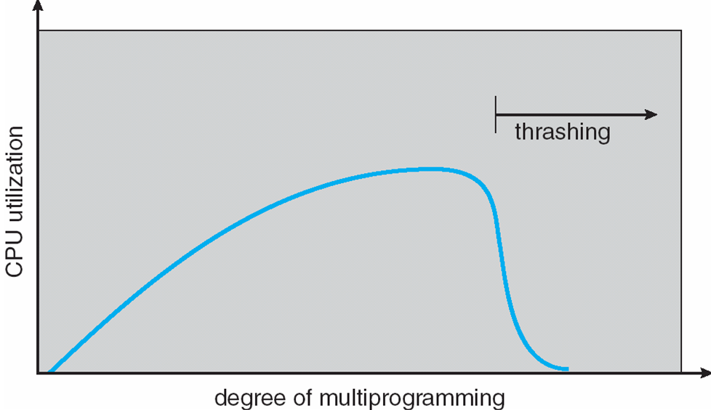
Thrashing (Cont.)
If global page replacement algorithm is used then thrashing occurs
To avoid this use local page replacement algorithm
Notes:
128
128
128
128

Slide 129
How to avoid thrashing?
Provide processes with as many frames as they need
How to determine this?
Look at how many frames a process actually "uses“
Locality model
Working set model
Page Fault Frequency Model
Notes:
129

